Slide 1
Mark Twain/Huck Finn Background
Mrs. Burhenn

Slide 2
Early Years
Samuel Clemens was born on November 30‚ 1835 in Florida‚ Missouri‚ the sixth of seven children. At the age of 4‚ Sam and his family moved to the small frontier town of Hannibal‚ Missouri‚ on the banks of the Mississippi River. Missouri‚ at the time‚ was a fairly new state (it had gained statehood in 1821) and comprised part of the country’s western border. It was also a slave state. Sam’s father owned one slave and his uncle owned several. In fact‚ it was on his uncle’s farm that Sam spent many boyhood summers playing in the slave quarters‚ listening to tall tales and the slave spirituals that he would enjoy throughout his life.
In 1847‚ when Sam was 11‚ his father died. Shortly thereafter he left school‚ having completed the fifth grade‚ to work as a printer’s apprentice for a local newspaper. His job was to arrange the type for each of the newspaper’s stories‚ allowing Sam to read the news of the world while completing his work.

Slide 3
Young Adult
At 18‚ Sam headed east to New York City and Philadelphia‚ where he worked on several different newspapers and found some success at writing articles. By 1857‚ he had returned home to embark on a new career as a riverboat pilot on the Mississippi River. With the outbreak of the Civil War in 1861‚ however‚ all traffic along the river came to a halt‚ as did Sam’s pilot career. Inspired by the times‚ Sam joined a volunteer Confederate unit called the Marion Rangers‚ but he quit after just two weeks.

Slide 4
Young Adult
In 1865‚ Sam’s first “big break” came with the publication of his short story‚ “Jim Smiley and His Jumping Frog ” in papers across the country. A year later‚ Sam was hired by the Sacramento Union to visit and report on the Sandwich Islands (now Hawaii). His writings were so popular that‚ upon his return‚ he embarked upon his first lecture tour‚ which established him as a successful stage performer.

Slide 5
Family Life
After courting for two years‚ Sam Clemens and Olivia (Livy) Langdon were married in 1870. They settled in Buffalo‚ New York‚ where Sam had become a partner‚ editor and writer for the daily newspaper the Buffalo Express. While living in Buffalo‚ their first child‚ Langdon Clemens‚ was born.

Slide 6
Success
Sam completed some of his most famous books‚ often finding a summer refuge for uninterrupted work at his sister-in-law’s farm in Elmira‚ N.Y. Novels such as The Adventures of Tom Sawyer (1876) and Life on the Mississippi (1883) captured both his Missouri memories and depictions of the American scene. Yet‚ his social commentary continued. The Prince and the Pauper (1881) explored class relations as does A Connecticut Yankee in King Arthur’s Court (1889) which‚ going a step further‚ criticized oppression in general while examining the period’s explosion of new technologies. And‚ in perhaps his most famous work‚ Adventures of Huckleberry Finn (1884)‚ Clemens‚ by the way he attacked the institution of slavery‚ railed against the failures of Reconstruction and the continued poor treatment of African Americans in his own time.
Huckleberry Finn was also the first book published by Sam’s own publishing company‚ The Charles L. Webster Company. In an attempt to gain control over publication as well as to make substantial profits‚ Sam created the publishing company in 1884. A year later‚ he contracted with Ulysses S. Grant to publish Grant’s memoirs; the two-volume set provided large royalties for Grant’s widow and was a financial success for the publisher as well.

Slide 7
Twain’s Darker Later Years
In these later years‚ Sam’s writings turned dark. They began to focus on human greed‚ cruelty and questioned the humanity of the human race. His public appearances followed suit and included a harshly sarcastic public introduction of Winston Churchill in 1900. Even though Sam’s lecture tour had managed to get him out of debt‚ his anti-government writings and speeches threatened his livelihood once again. Labeled by some as a traitor‚ several of Sam’s works were never published during his lifetime either because magazines would not accept them or because of a personal fear that his marketable reputation would be ruined.
In 1903‚ after living in New York City for three years‚ Livy became ill and Sam and his wife returned to Italy where she died a year later. After her death‚ Sam lived in New York until 1908 when he moved into his last house‚ “Stormfield”‚ in Redding‚ Connecticut. In 1909‚ his middle daughter Clara was married. In the same year Jean‚ the youngest daughter‚ died from an epileptic seizure. Four months later on April 21‚ 1910‚ Sam Clemens died at the age of 74.

Slide 8
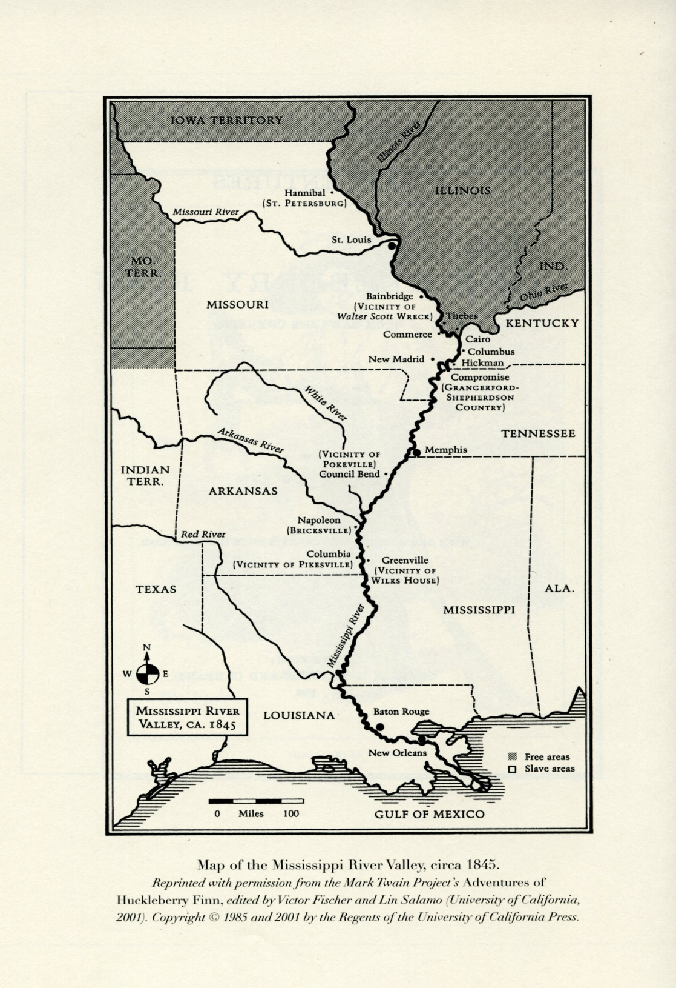
Map of the Mississippi River Valley

Slide 9
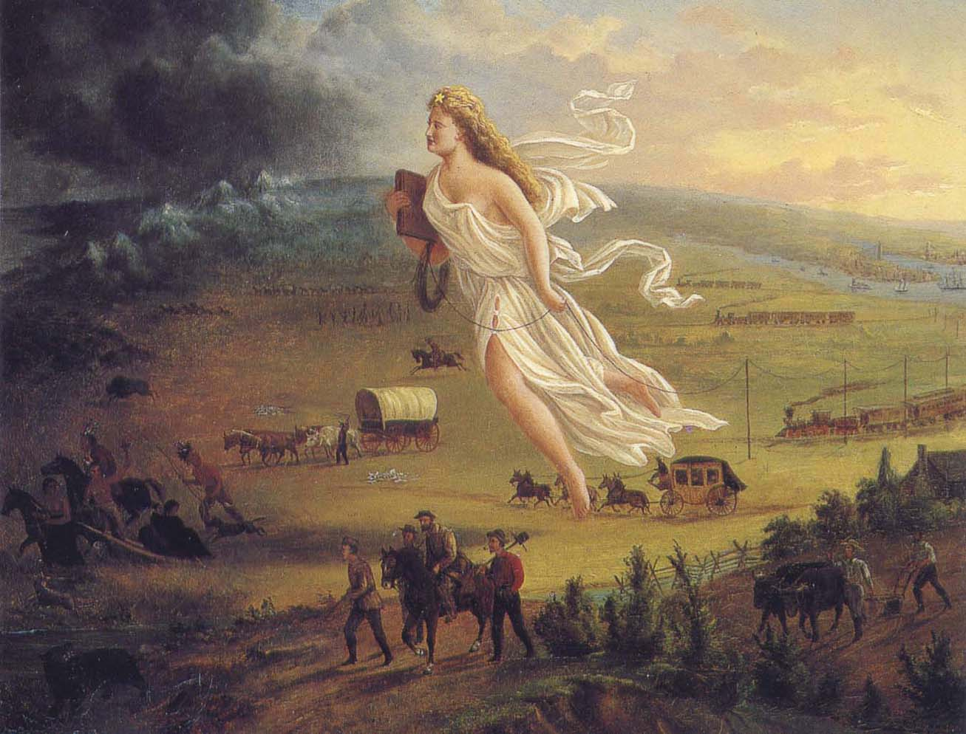
John Gast’s “American Progress or Manifest Destiny”

Slide 10
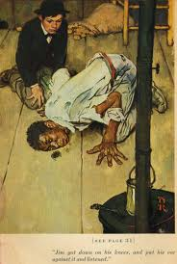
Norman Rockwell’s 1940 Illustration, “Jim and the Hairball”

Slide 11
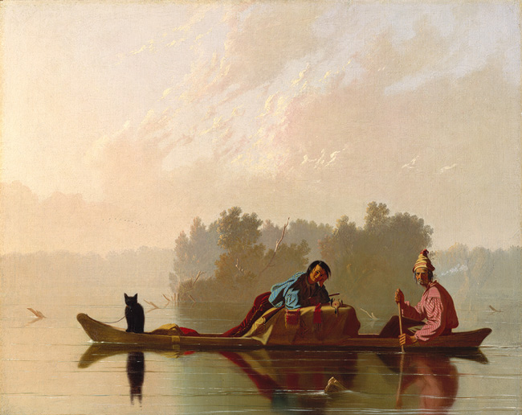
George Caleb Bingham’s “Fur Traders Descending the Missouri”

Slide 12
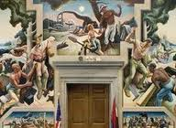
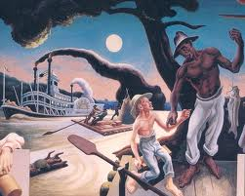
Thomas Hart Benton’s 1936 mural, “A Social History of the State of Missouri

Slide 13
Anticipation Guide
Pre Author Narr Post
_____ _____ _____ _____ 1. A good education makes a good person.
_____ _____ _____ _____ 2. It is better to follow laws, even if we don’t agree with all of them.
_____ _____ _____ _____ 3. Children should obey and respect adults.
_____ _____ _____ _____ 4. The ability to read and write is the most important skill a person can learn in life.
_____ _____ _____ _____ 5. An adolescent’s behavior is influenced by friends more than anything else.
_____ _____ _____ _____ 6. An adolescent’s attitudes are influenced by parents more than anything else.
_____ _____ _____ _____ 7. A person must “play the game” to survive.
_____ _____ _____ _____ 8. “Game playing” is dishonest.
_____ _____ _____ _____ 9. Cruelty begets cruelty and kindness begets kindness.
_____ _____ _____ _____ 10. When bad things happen to a person, he/she has done something to cause them.

